Slide 1





Saydalia Online
A Modern Pharmacy Management System
AST Company
By MedTech Team
MedTech Team

Slide 2






MedTech Team
Mahmoud Badr AboHussiba
Mohamed Attia Bekhit
Heba Adel Ahmed
Hager Ahmed Ali
Mahmoud Mohamed Abdelrahim
MedTech Team

Slide 3

Contents
01
02
03
Problem Statement
Introduction
How It Works?
04
05
06
Technologies
Back-end Architecture
Members Achievements
MedTech Team

Slide 4


Our Solution
Problem
A platform offering a vast catalog of medicines, health supplements, and wellness products
01
Difficulty in accessing medications, especially for busy or elderly people.
Lack of time or transport to visit a pharmacy.
Risk of errors in manually comparing medicines and prices.
02
Safe and secure home delivery options.
03
Simple search and filtering options to quickly find what users need..
MedTech Team

Slide 5

Introduction
Saydalia Online is a digital pharmacy that makes it easy to get the medicines and health products you need from home. With a wide range of medicines, vitamins, and wellness items, you can browse, compare, and order your products quickly.
Our easy-to-use website helps you find the right medicines, read product details, check prices, and see alternative choices. You can place an order in just a few steps, pick your delivery option, and have your medicines delivered safely to your door.
MedTech Team

Slide 6

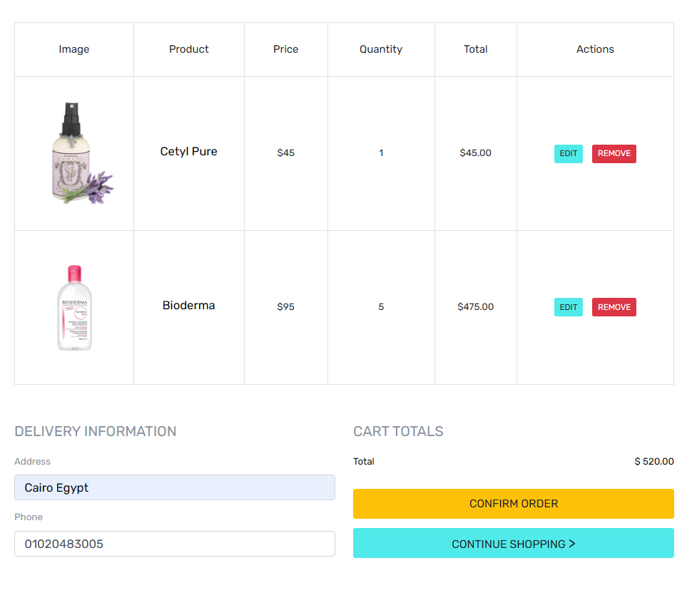
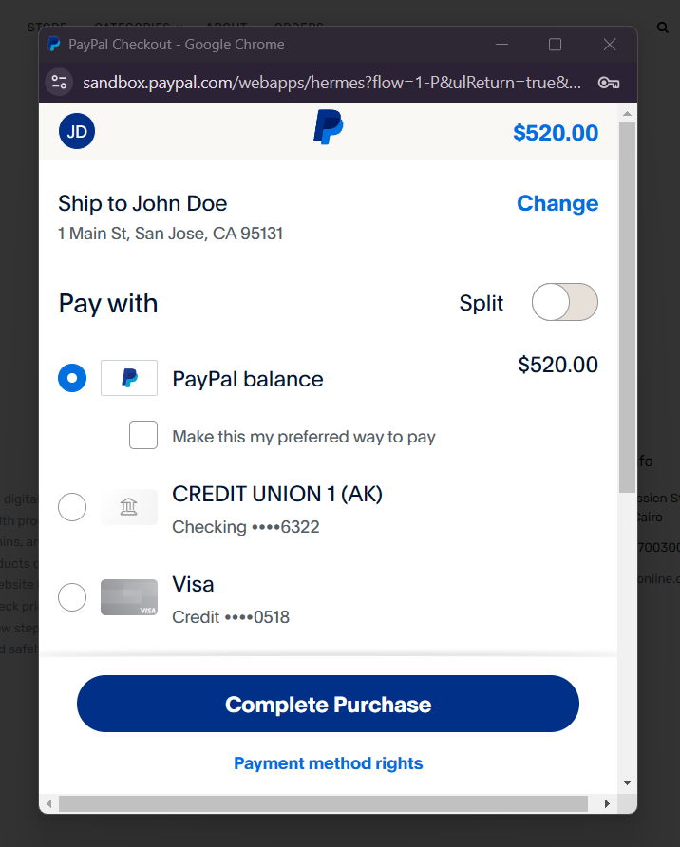
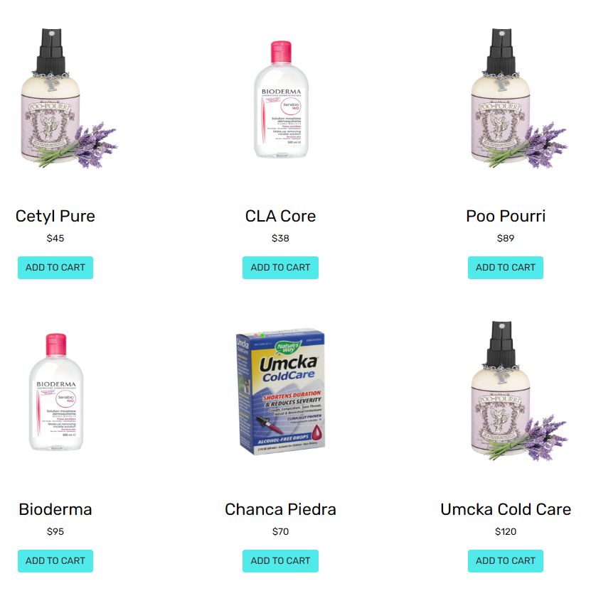

How it Works
Browse and Select
Confirm Order
Easy Payment
Search and compare medicines or health products.
Complete the order and choose delivery options.
Pay with your Paypal account
Click Here to See The Demo
MedTech Team

Slide 7

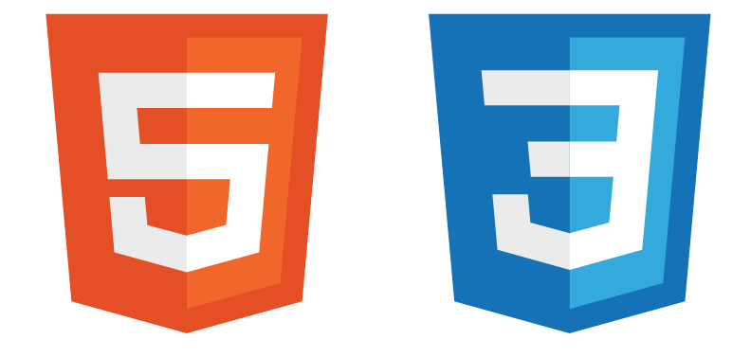



Technologies
Re
Repository
Design Pattern
Provides secure, seamless payment processing for users.
For a maintainable code and separates logic from data access, ensuring long-term flexibility.
Ensures scalability, security, and maintainability.
For storing data in a relational database
For a good user interface and user experience.
MedTech Team

Slide 8

Back-end Architecture
Controller Handles HTTP requests and directs them to the appropriate services.
Database Entities
Medicines
Categories
Orders
OrderItems
Users
Roles
Browser Requests
Service Contains the business logic and coordinates between the controller and repository.
Repository Manages data access, handling CRUD operations and interactions with the database.
MedTech Team

Slide 9


Members Achievements
Feature | Team Member
Database Design | All Members
Medicine CURD Operations | H.Adel & H.Ahmed
Search For Medicine | M.Mohamed
Category CURD Operations | M.Mohamed
Generic Repository | H.Adel
Pagination | H.Ahmed
User Profile Management | M.Badr and M.Attia
Authentication Implementation | M.Attia
Authorization Implementation | M.Attia
Orders and Cart Management | M.Badr and M.Attia
PayPal Payment | M.Badr
Password Reset via Email | M.Badr
MedTech Team

Slide 10





THANK YOU!
+201155700300
saydaliaonline.depi@gmail.com
www.saydaliaonline.com
Taha Hussien Street, El-Nozha, Cairo
MedTech Team

